Slide 1
Introduction to Deep Learning: Algorithms and Their Applications
CDC Short Course
Xiaoming Huo, Georgia Tech

Slide 2
Schedule
8:30-9:30 Module 1: Introduction
9:45-10:45 Module 2: Overview & preparation
11:00-12:00 Module 3: Neural networks - basics
12:00-1:15 Lunch break
1:15-2:00 Module 4: Neural networks - models
2:15-3:00 Module 5: Convolutional neural networks
3:15-4:00 Module 6: Some examples
4:00 Adjourn
Online resources: https://github.com/xhuo17/CDC_DL_2022

Slide 3
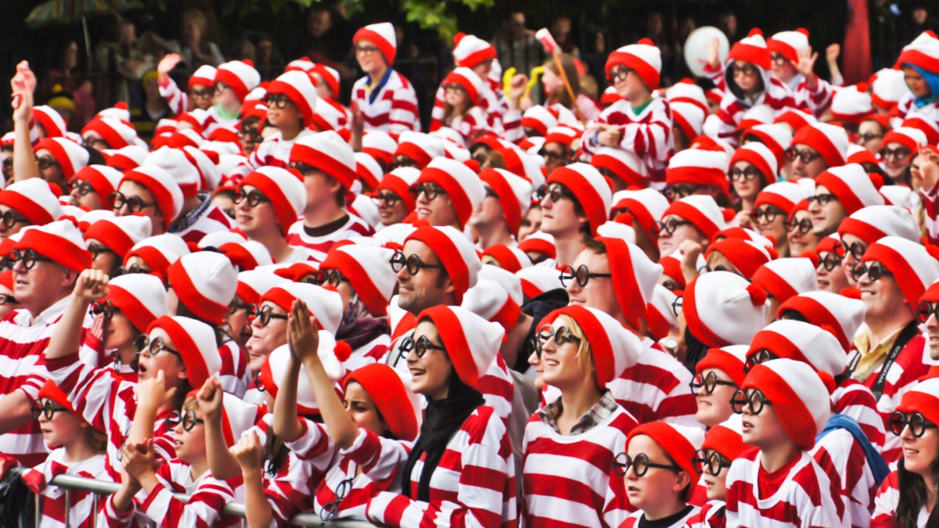
Convolutions
courses.d2l.ai/berkeley-stat-157

Slide 4
Classifying Dogs and Cats in Images
• Use a good camera
• RGB image has 36M elements
• The model size of a single hidden layer MLP with a 100 hidden size is 3.6 Billion parameters
• Exceeds the population of dogs
and cats on earth
(900M dogs + 600M cats)

Slide 5
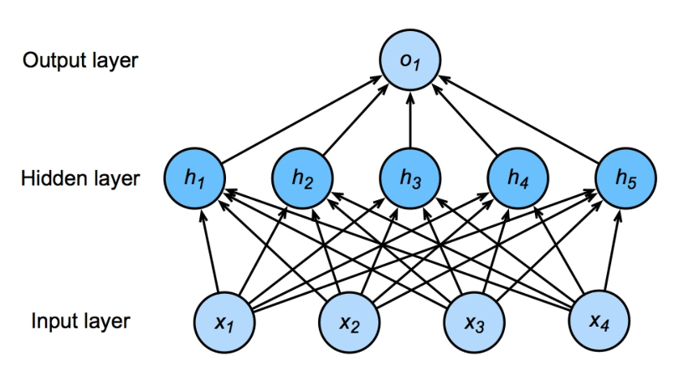
Flashback - Network with one hidden layer
100 neurons
3.6B parameters = 14GB 36M features
h = σ (Wx + b)

Slide 6
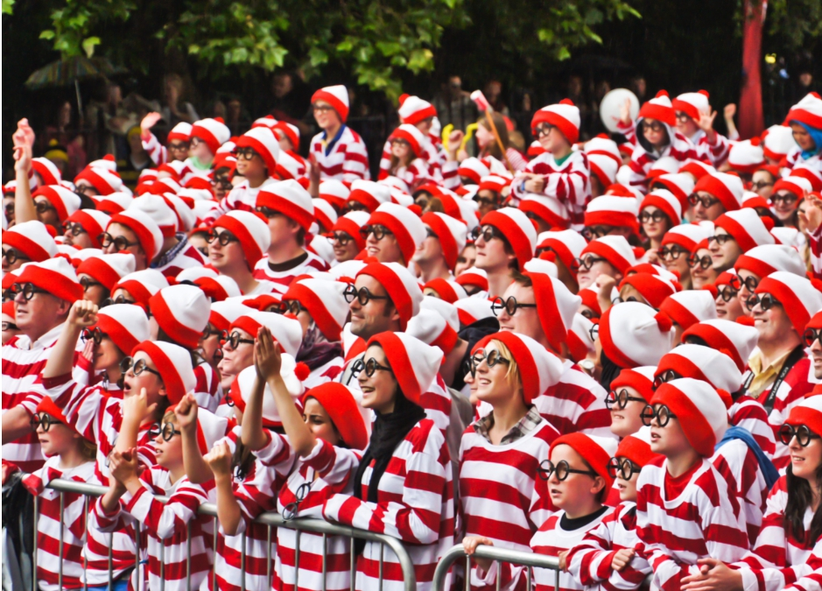
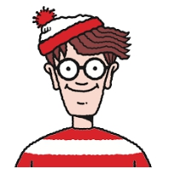
Where is Waldo?

Slide 7
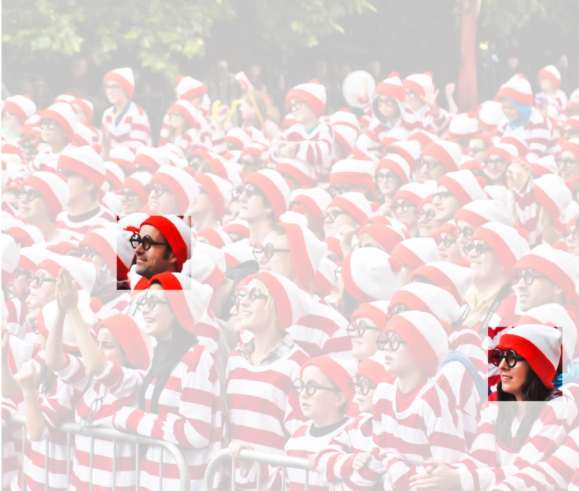
Two Principles
• Translation
Invariance
• Locality
courses.d2l.ai/berkeley-stat-157

Slide 8
Rethinking Dense Layers
• Reshape inputs and output into matrix (width, height)
• Reshape weights into 4-D tensors (h,w) to (h’,w’)
V is re-indexes W such as that

Slide 9

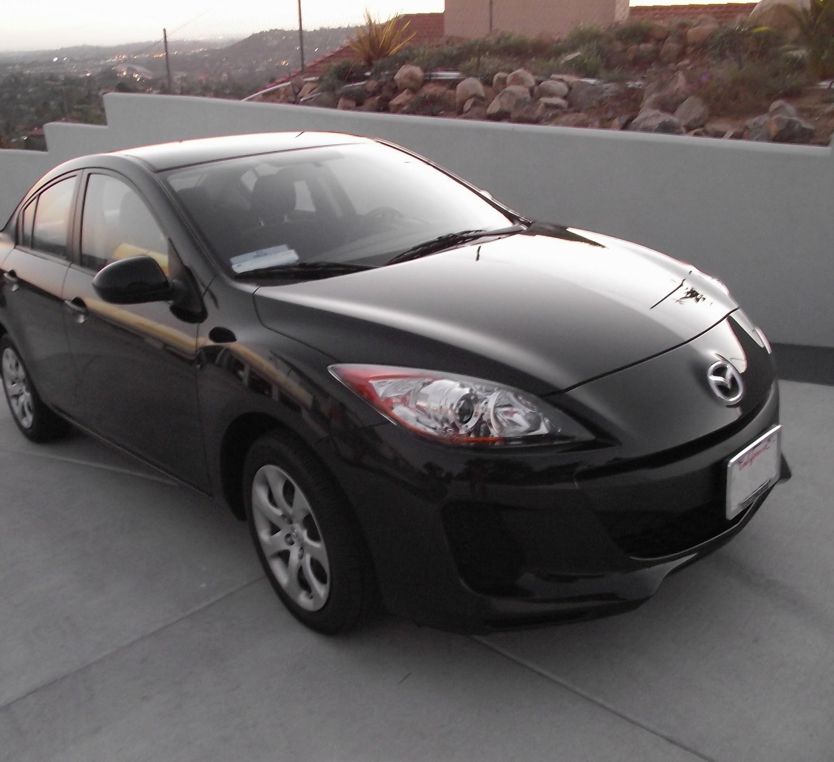
Fully Connected Layer (FC layer)
Contains neurons that connect to the entire input volume, as in ordinary Neural Networks
Slide Credit: Fei-Fei Li, Justin Johnson, Serena Yeung, CS 231n
Notes:
Car image is photo taken by Lane McIntosh, permission to use.

Slide 10
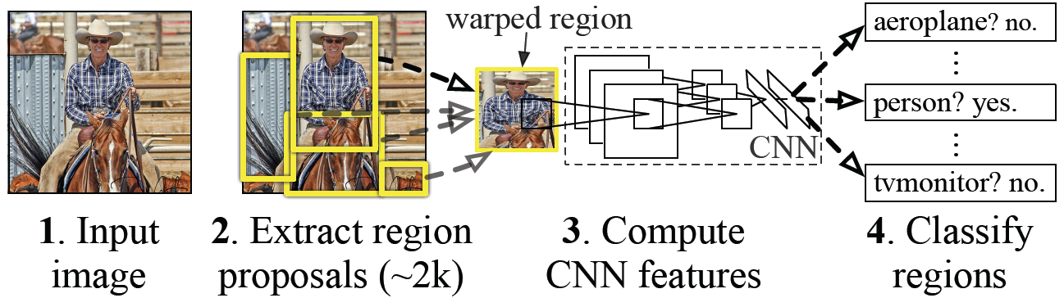
Classical View = Inefficient

Slide 11
Idea #1 - Translation Invariance
• A shift in x also leads to a shift in h
• v should not depend on (i,j). Fix via
hi,j = ∑ a,b
That’s a 2-D convolution
cross-correlation

Slide 12
Idea #2 - Locality
• We shouldn’t look very far from x(i,j) in order to assess
what’s going on at h(i,j)
• Outside range | a | , | b | > Δ parameters vanish

Slide 13
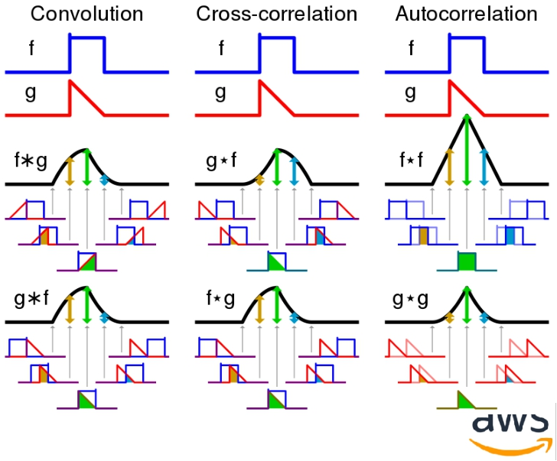
Convolution

Slide 14


"Convolution of box signal with itself2" by Convolution_of_box_signal_with_itself.gif: Brian Ambergderivative work: Tinos (talk) - Convolution_of_box_signal_with_itself.gif. Licensed under CC BY-SA 3.0 via Commons - https://commons.wikimedia.org/wiki/File:Convolution_of_box_signal_with_itself2.gif#/media/File:Convolution_of_box_signal_with_itself2.gif

Slide 15
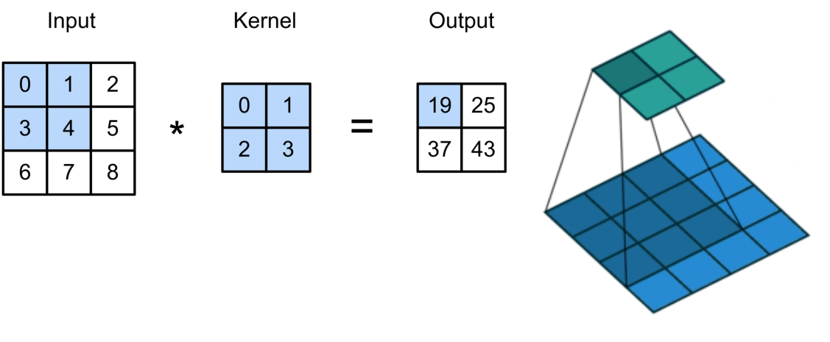
2-D Cross Correlation
0 × 0 + 1 × 1 + 3 × 2 + 4 × 3 = 19,
1 × 0 + 2 × 1 + 4 × 2 + 5 × 3 = 25,
3 × 0 + 4 × 1 + 6 × 2 + 7 × 3 = 37,
4 × 0 + 5 × 1 + 7 × 2 + 8 × 3 = 43.
(vdumoulin@ Github)

Slide 16
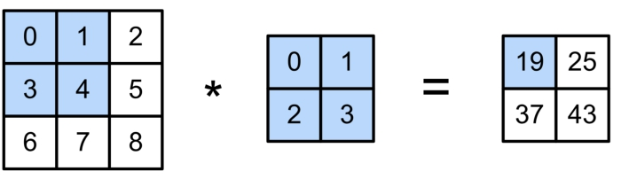
2-D Convolution Layer
Y = X ⋆ W + b
• W and b are learnable parameters

Slide 17

Figure Credit: Dumoulin and Visin, https://arxiv.org/pdf/1603.07285.pdf

Slide 18
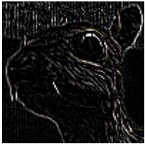
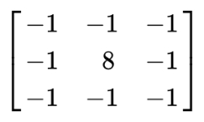
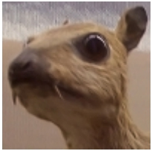
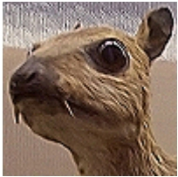
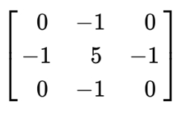
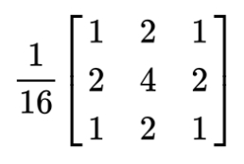
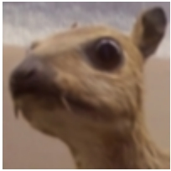
Examples
Edge Detection
Sharpen
(wikipedia)
Gaussian Blur

Slide 19
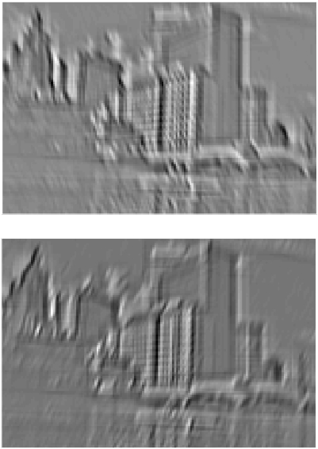
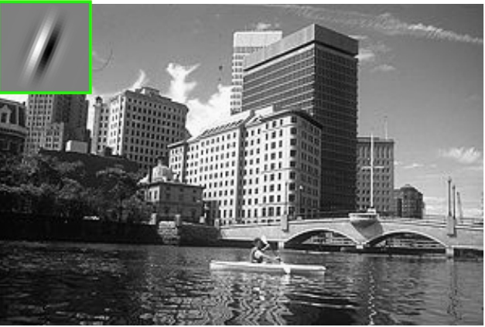
Examples
(Rob Fergus)

Slide 20
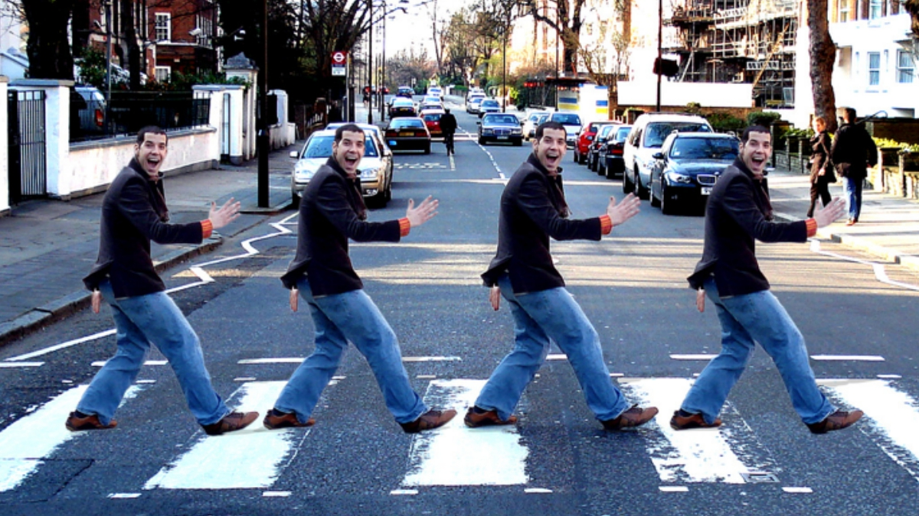
Padding and Stride
courses.d2l.ai/berkeley-stat-157

Slide 21
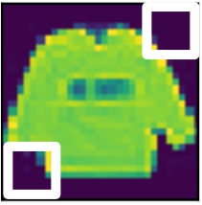
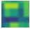
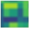
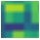
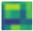
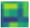
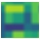
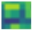

Padding
• Given a 32 x 32 input image
• Apply convolutional layer with 5 x 5 kernel
• 28 x 28 output with 1 layer
• 4 x 4 output with 7 layers
• Shape decreases faster with larger kernels
• Shape reduces from to

Slide 22
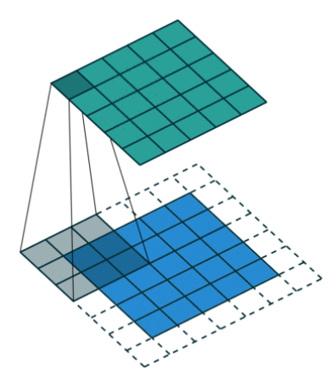
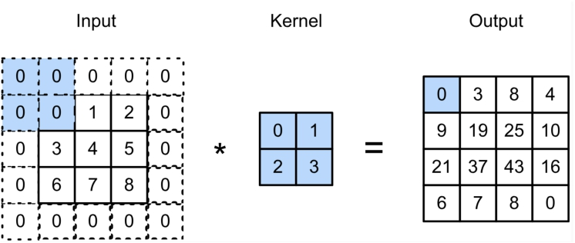
Padding
Padding adds rows/columns around input
0 × 0 + 0 × 1 + 0 × 2 + 0 × 3 = 0

Slide 23
Padding

Slide 24
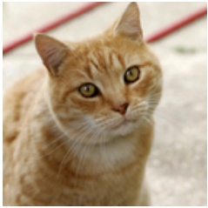
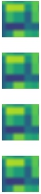
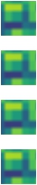
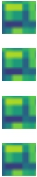

Stride
• Padding reduces shape linearly with #layers
• Given a 224 x 224 input with a 5 x 5 kernel, needs 44
layers to reduce the shape to 4 x 4
• Requires a large amount of computation

Slide 25
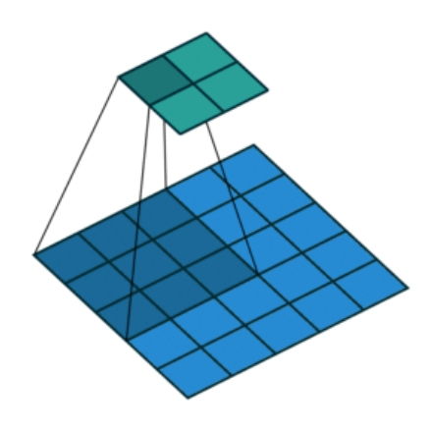
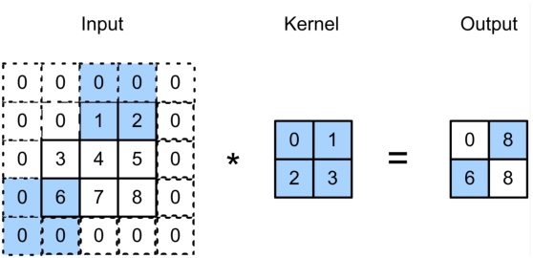
Stride
• Stride is the #rows/#columns per slide
Strides of 3 and 2 for height and width
0 × 0 + 0 × 1 + 1 × 2 + 2 × 3 = 8
0 × 0 + 6 × 1 + 0 × 2 + 0 × 3 = 6

Slide 26
Stride

Slide 27
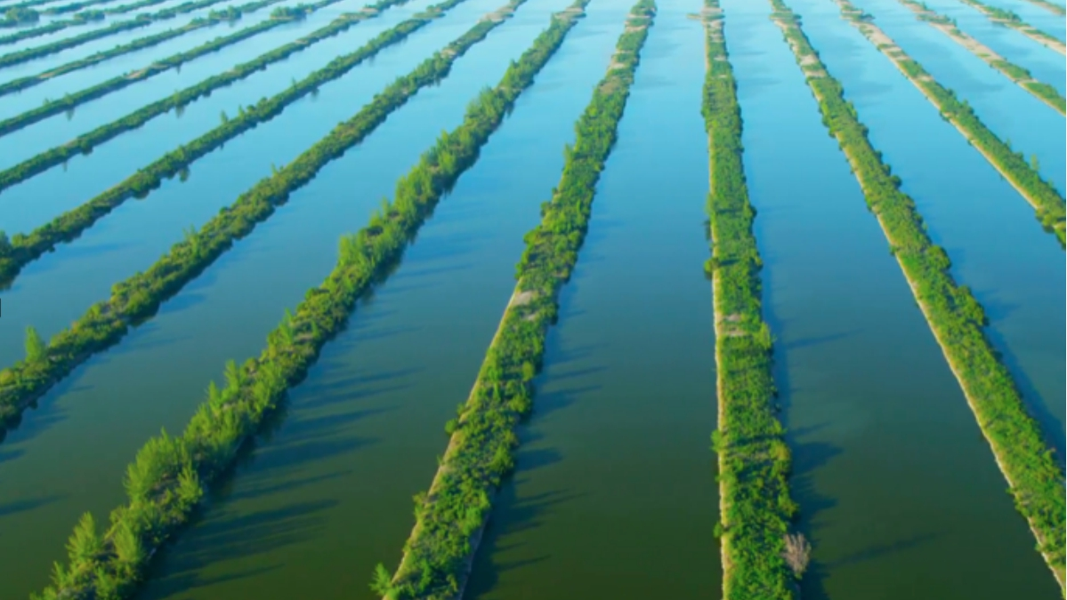
Multiple Input and Output Channels
courses.d2l.ai/berkeley-stat-157

Slide 28
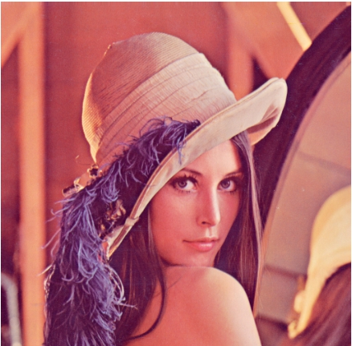
Multiple Input Channels
• Color image may have three RGB channels
• Converting to grayscale loses information

Slide 29
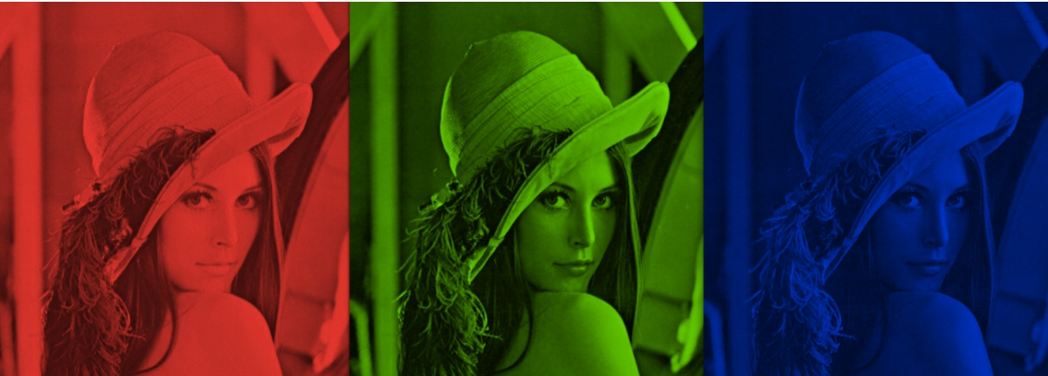
Multiple Input Channels
• Color image may have three RGB channels
• Converting to grayscale loses information

Slide 30
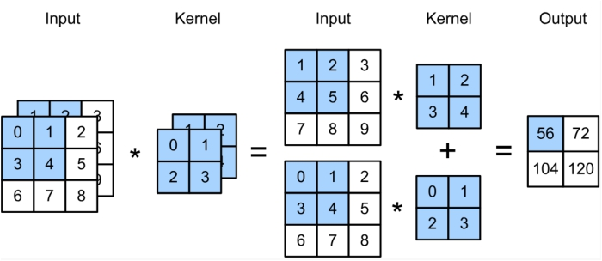

Multiple Input Channels
• Have a kernel for each channel, and then sum results
over channels
(1 × 1 + 2 × 2 + 4 × 3 + 5 × 4)
+(0 × 0 + 1 × 1 + 3 × 2 + 4 × 3) = 56

Slide 31
Multiple Input Channels

Slide 32
Multiple Output Channels
• No matter how many inputs channels, so far, we always
get single output channel
• We can have multiple 3-D kernels, each one generates a
output channel
• Input
• Kernel
• Output

Slide 33
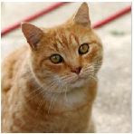
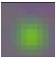
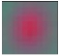

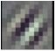
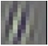

Multiple Input/Output Channels
• Each output channel may recognize a particular pattern
• Input channels kernels recognize and combines patterns
in inputs

Slide 34
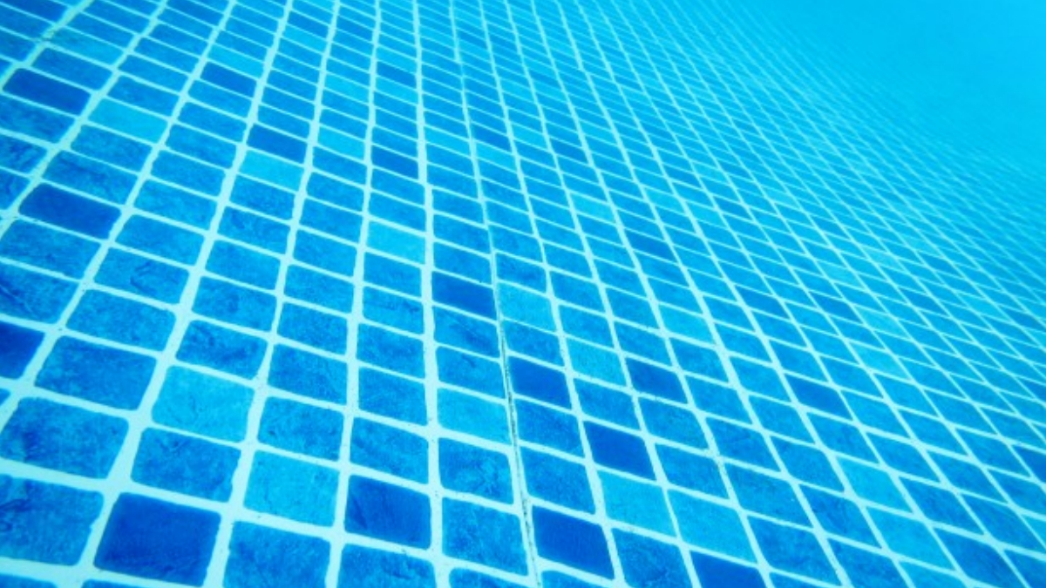
Pooling Layer

Slide 35

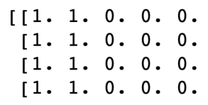
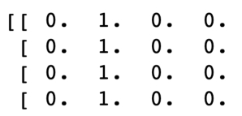
Pooling
• Convolution is sensitive to position
• Detect vertical edges
X Y
0 output with
1 pixel shift
• We need some degree of invariance to translation
• Lighting, object positions, scales, appearance vary
among images

Slide 36
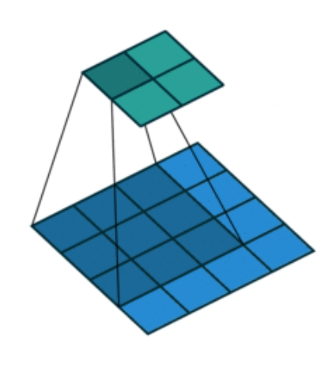
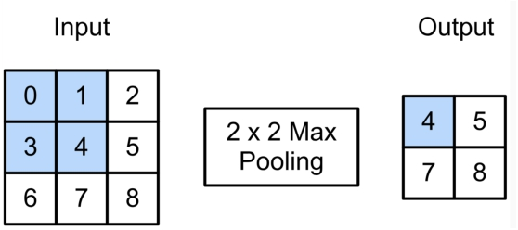
2-D Max Pooling
• Returns the maximal value in the
sliding window
max(0,1,3,4) = 4

Slide 37



2-D Max Pooling
• Returns the maximal value in the sliding window
Vertical edge detection Conv output 2 x 2 max pooling
Tolerant to 1
pixel shift

Slide 38

Padding, Stride, and Multiple Channels
• Pooling layers have similar padding
and stride as convolutional layers
• No learnable parameters
• Apply pooling for each input channel to obtain the corresponding output channel
#output channels = #input channels

Slide 39


Average Pooling
• Max pooling: the strongest pattern signal in a window
• Average pooling: replace max with mean in max pooling
• The average signal strength in a window
Max pooling Average pooling

Slide 40

LeNet Architecture
gluon-cv.mxnet.io

Slide 41

Expensive if we
have many
outputs
gluon-cv.mxnet.io

Slide 42

Handwritten Digit Recognition

Slide 43

MNIST
• Centered and scaled
• 50,000 training data
• 10,000 test data
• 28 x 28 images
• 10 classes

Slide 44

Y. LeCun, L. Bottou, Y. Bengio, P. Haffner, 1998 Gradient-based learning applied to document recognition

Slide 45
Image Segmentation (Image Registration)

Slide 46



Other Computer Vision Tasks
Semantic Segmentation
2D Object Detection
3D Object Detection
GRASS, CAT, TREE, SKY
DOG, DOG, CAT
Car
Object categories +
2D bounding boxes
Object categories +
3D bounding boxes
No objects, just pixels
This image is CC0 public domain
Slide Credit: Fei-Fei Li, Justin Johnson, Serena Yeung, CS 231n

Slide 47
Semantic Segmentation
Semantic Segmentation
2D Object Detection
3D Object Detection
GRASS, CAT, TREE, SKY
DOG, DOG, CAT
Car
Object categories +
2D bounding boxes
Object categories +
3D bounding boxes
No objects, just pixels
This image is CC0 public domain
Notes:
Given this cute cat picture, the image classification task would be looking at this picture and ouput a single label cat

Slide 48

Semantic Segmentation
This image is CC0 public domain
Label each pixel in the image with a category label
Don’t differentiate instances, only care about pixels
Sky
Trees
Sky
Trees
Cat
Cow
Grass
Grass
Slide Credit: Fei-Fei Li, Justin Johnson, Serena Yeung, CS 231n

Slide 49

Semantic Segmentation Idea: Sliding Window
Extract patch
Classify center pixel with CNN
Full image
Cow
Cow
Grass
Farabet et al, “Learning Hierarchical Features for Scene Labeling,” TPAMI 2013
Pinheiro and Collobert, “Recurrent Convolutional Neural Networks for Scene Labeling”, ICML 2014
Slide Credit: Fei-Fei Li, Justin Johnson, Serena Yeung, CS 231n

Slide 50
Semantic Segmentation Idea: Sliding Window
Extract patch
Classify center pixel with CNN
Full image
Cow
Cow
Grass
Problem: Very inefficient! Not reusing shared features between overlapping patches
Farabet et al, “Learning Hierarchical Features for Scene Labeling,” TPAMI 2013
Pinheiro and Collobert, “Recurrent Convolutional Neural Networks for Scene Labeling”, ICML 2014
Slide Credit: Fei-Fei Li, Justin Johnson, Serena Yeung, CS 231n

Slide 51
Semantic Segmentation Idea: Fully Convolutional
Design a network as a bunch of convolutional layers to make predictions for pixels all at once!
Conv
Conv
Conv
Conv
argmax
Input:
3 x H x W
Predictions:
H x W
Scores:
C x H x W
Convolutions:
D x H x W
Slide Credit: Fei-Fei Li, Justin Johnson, Serena Yeung, CS 231n

Slide 52
Semantic Segmentation Idea: Fully Convolutional
Design a network as a bunch of convolutional layers to make predictions for pixels all at once!
Conv
Conv
Conv
Conv
argmax
Input:
3 x H x W
Predictions:
H x W
Scores:
C x H x W
Problem: convolutions at original image resolution will be very expensive ...
Convolutions:
D x H x W
Slide Credit: Fei-Fei Li, Justin Johnson, Serena Yeung, CS 231n

Slide 53
Semantic Segmentation Idea: Fully Convolutional
Design network as a bunch of convolutional layers, with downsampling and upsampling inside the network!
Med-res:
D₂ x H/4 x W/4
Med-res:
D₂ x H/4 x W/4
Low-res:
D₃ x H/4 x W/4
Input:
3 x H x W
High-res:
D₁ x H/2 x W/2
High-res:
D₁ x H/2 x W/2
Predictions:
H x W
Long, Shelhamer, and Darrell, “Fully Convolutional Networks for Semantic Segmentation”, CVPR 2015 Noh et al, “Learning Deconvolution Network for Semantic Segmentation”, ICCV 2015
Slide Credit: Fei-Fei Li, Justin Johnson, Serena Yeung, CS 231n

Slide 54
Semantic Segmentation Idea: Fully Convolutional
Downsampling:
Pooling, strided convolution
Design network as a bunch of convolutional layers, with downsampling and upsampling inside the network!
Upsampling:
???
Med-res:
D₂ x H/4 x W/4
Med-res:
D₂ x H/4 x W/4
Low-res:
D₃ x H/4 x W/4
Input:
3 x H x W
High-res:
D₁ x H/2 x W/2
High-res:
D₁ x H/2 x W/2
Predictions:
H x W
Long, Shelhamer, and Darrell, “Fully Convolutional Networks for Semantic Segmentation”, CVPR 2015 Noh et al, “Learning Deconvolution Network for Semantic Segmentation”, ICCV 2015
Slide Credit: Fei-Fei Li, Justin Johnson, Serena Yeung, CS 231n

Slide 55

Figure Credit: https://medium.com/apache-mxnet/transposed-convolutions-explained-with-ms-excel-52d13030c7e8

Slide 56
Linear Algebra: Toeplitz Matrix

Slide 57


Toeplitz Matrix
Diagonals are constants
A_{ij} = a_{i-j}

Slide 58
Why do we care?
(Discrete) Convolution = Matrix Multiplication
with Toeplitz Matrices
. . .

Slide 59
Software Demo
1channels.ipynb
2lenet.ipynb
3pooling.ipynb
4conv-layer.ipynb
5 padding-and-strides.ipynb

